Slide 1
General Purpose IO (GPIO) (Low level IO)
Md. Khalilur Rhaman PhD
Associate Professor
CSE Department
BRAC University
Notes:
‹#›

Slide 2
Basic Concepts in I/O Interfacing
I/O devices (or peripherals) such as LEDs, LCDs, keyboards etc. are essential components of the microprocessor-based or microcontroller-based systems. Those can be classified into two groups
input devices
output devices

Slide 3
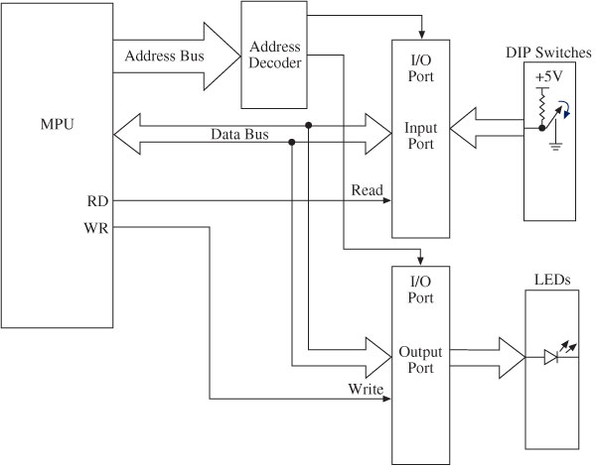
Block Diagram of I/O Interfacing
Buffer
Latch
Buffer keep the level of 0 or 1 (to resolve fan in problem)
Latch hold the value (0/1) until it is cleared

Slide 4
I/O Ports: Interfacing and Addressing
To read (receive) binary data from an input peripheral
MPU places the address of an input port on the address bus, enables the input port by asserting the RD signal, and reads data using the data bus.
To write (send) binary data to an output peripheral
MPU places the address of an output port on the address bus, places data on data bus, and asserts the WR signal to enable the output port.

Slide 5
Output
Light Emitting Diode (LED)
Seven segment display (Alphanumaric)
Matrix Display
Liquid Crystal Display (LCD)
Buzzer
DC Motor
Servo Motor
Stepper Motor

Slide 6
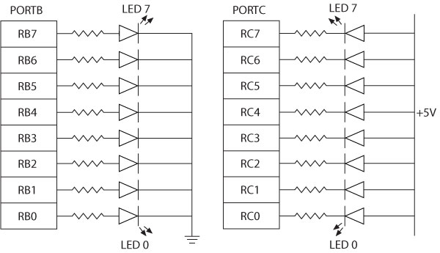
Interfacing LED
Two ways of connecting LEDs to I/O ports:
Common Cathode - The current is supplied by the I/O port called current sourcing.
Common Anode - The current is received by the chip called current sinking.
Common Cathode
Common Anode

Slide 7
Interfacing Seven-Segment
Seven-segment LEDs
Often used to display BCD numbers (0 through 9) and a few alphabets
A group of eight LEDs physically mounted in the shape of the number eight plus a decimal point
Each LED is called a segment and labeled as ‘a’ through ‘g’.

Slide 8
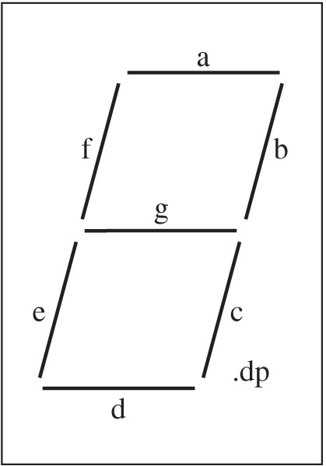
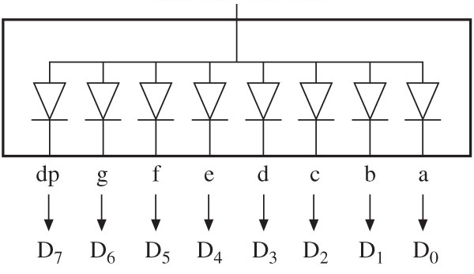
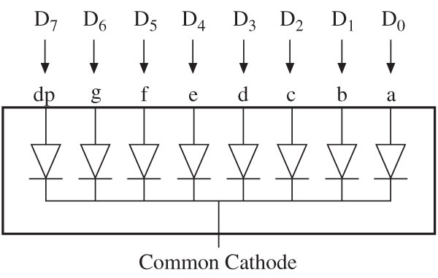
Interfacing Seven-Segment
Two types of seven-segment LEDs
Common anode
Common cathode
Common anode
decimal point

Slide 9
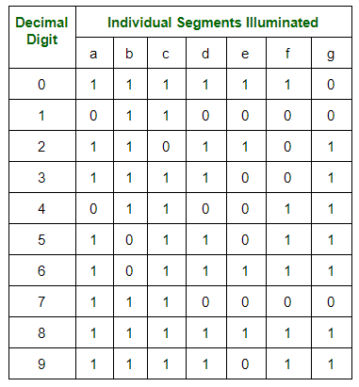
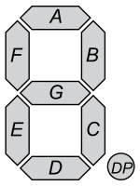
7 segment display
h

Slide 10
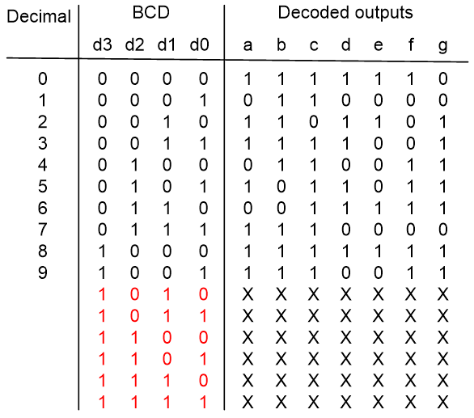
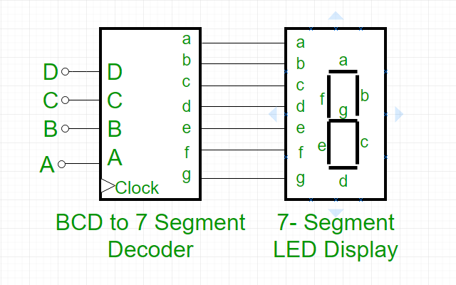
7 Segment Display
D3
D2
D0
D1

Slide 11
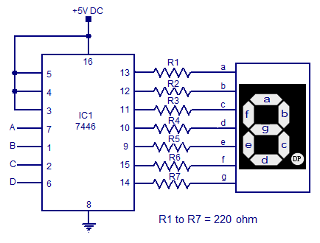
7 Segment Display

Slide 12
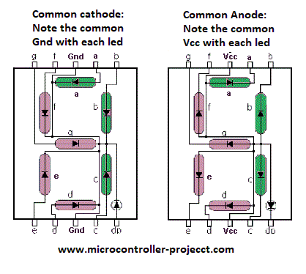
Common Cathode/ Common Anode

Slide 13
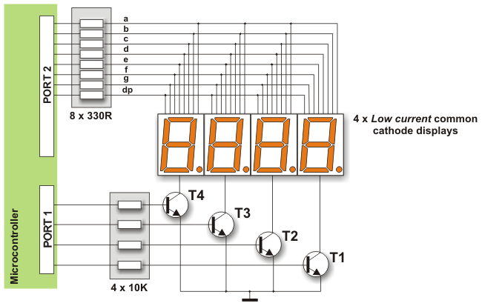
1. 4 displays are connected to Port 2
T4 | T3 | T2 | T1
1 | 0 | 0 | 0
0 | 1 | 0 | 0
0 | 0 | 1 | 0
0 | 0 | 0 | 1
1 | 0 | 0 | 0

Slide 14
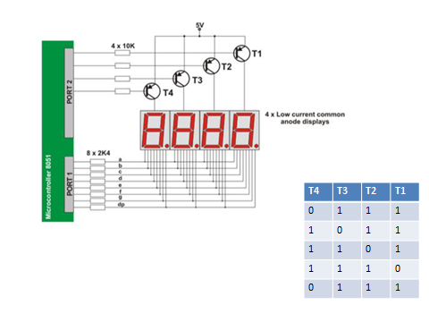
Common Anode Config

Slide 15
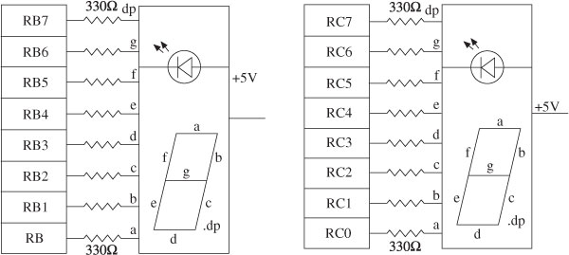
Interfacing Seven-Segment LEDS to PORTs

Slide 16
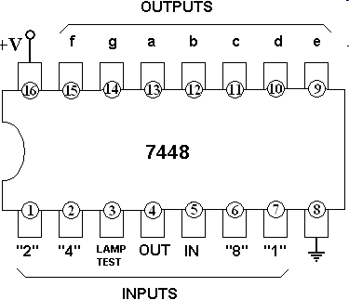
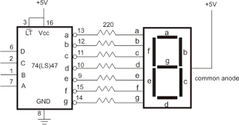
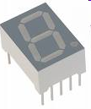
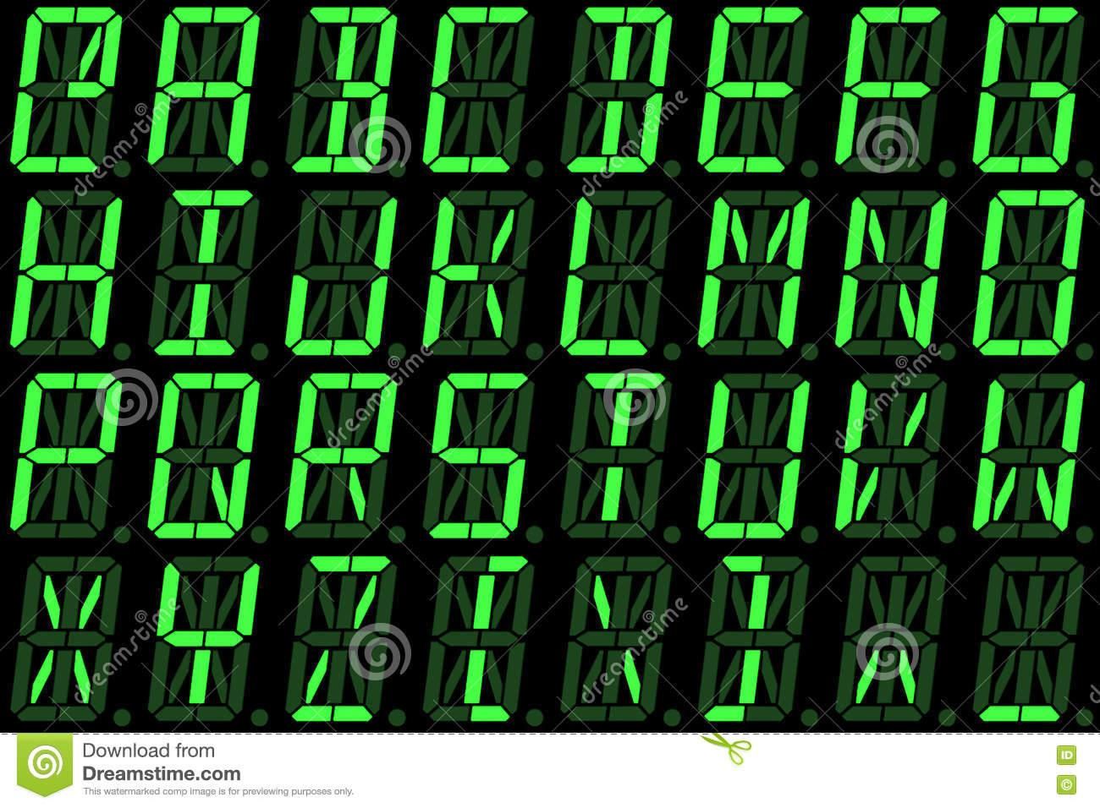
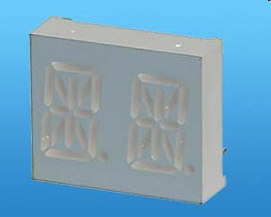
Seven-Segment Chips
ALPHA/NUMERIC DISPLAY

Slide 17
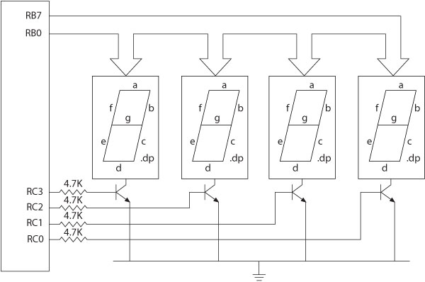

Interfacing to Multiple 7-Segments

Slide 18
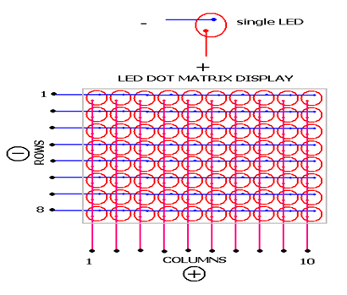
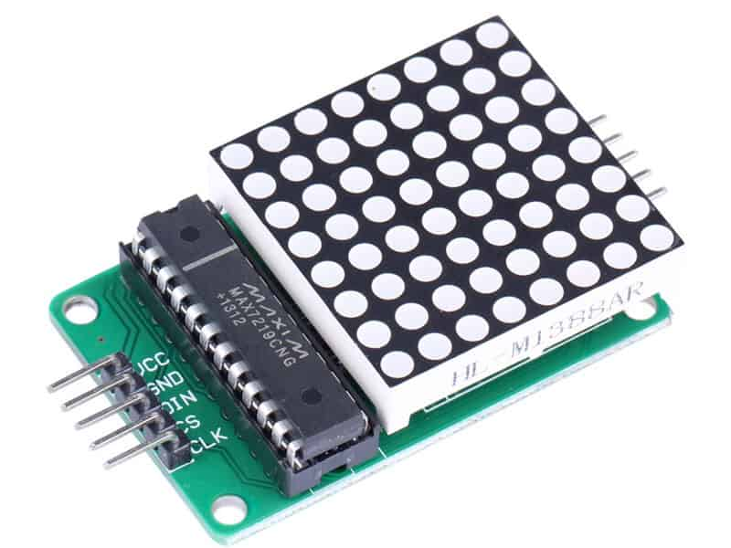
LED Matrix Display

Slide 19
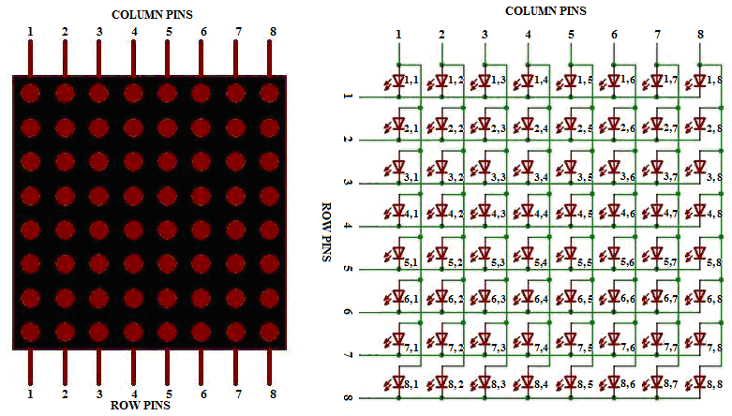
LED Matrix Display
Anode Columns
Cathode Rows

Slide 20
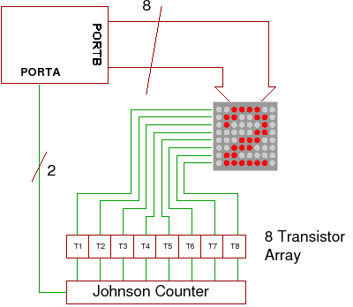
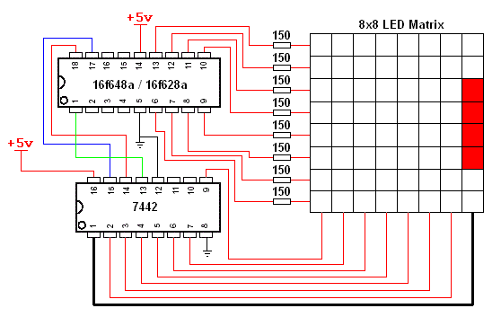
LED Matrix Display

Slide 21
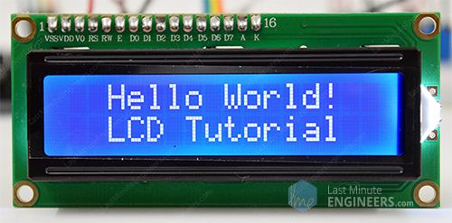
LCD
Interface a 2-line x 16 character LCD module with the built-in controller to I/O ports of the PIC18 microcontroller
LCD has a display Data RAM (registers) that stores data in 8-bit character code in ASCII.
Each register in Data RAM has its own address that corresponds to its position on the line.

Slide 22
LCD
Three control signals:
RS (Register Select)
RW (Read/Write)
E (Enable)
Three power connections
Power,
Ground
Variable register to control the brightness
Driver has two 8-bit internal registers
Instruction Register (IR) to write instructions to set up LCD
Data Register (DR) to write data (ASCII characters)

Slide 23
LCD
Display
RAM
Command/ Instruction Register
Data Register
RS = 0
RS = 1
Microcontroller
RW = 0 (Write)

Slide 24
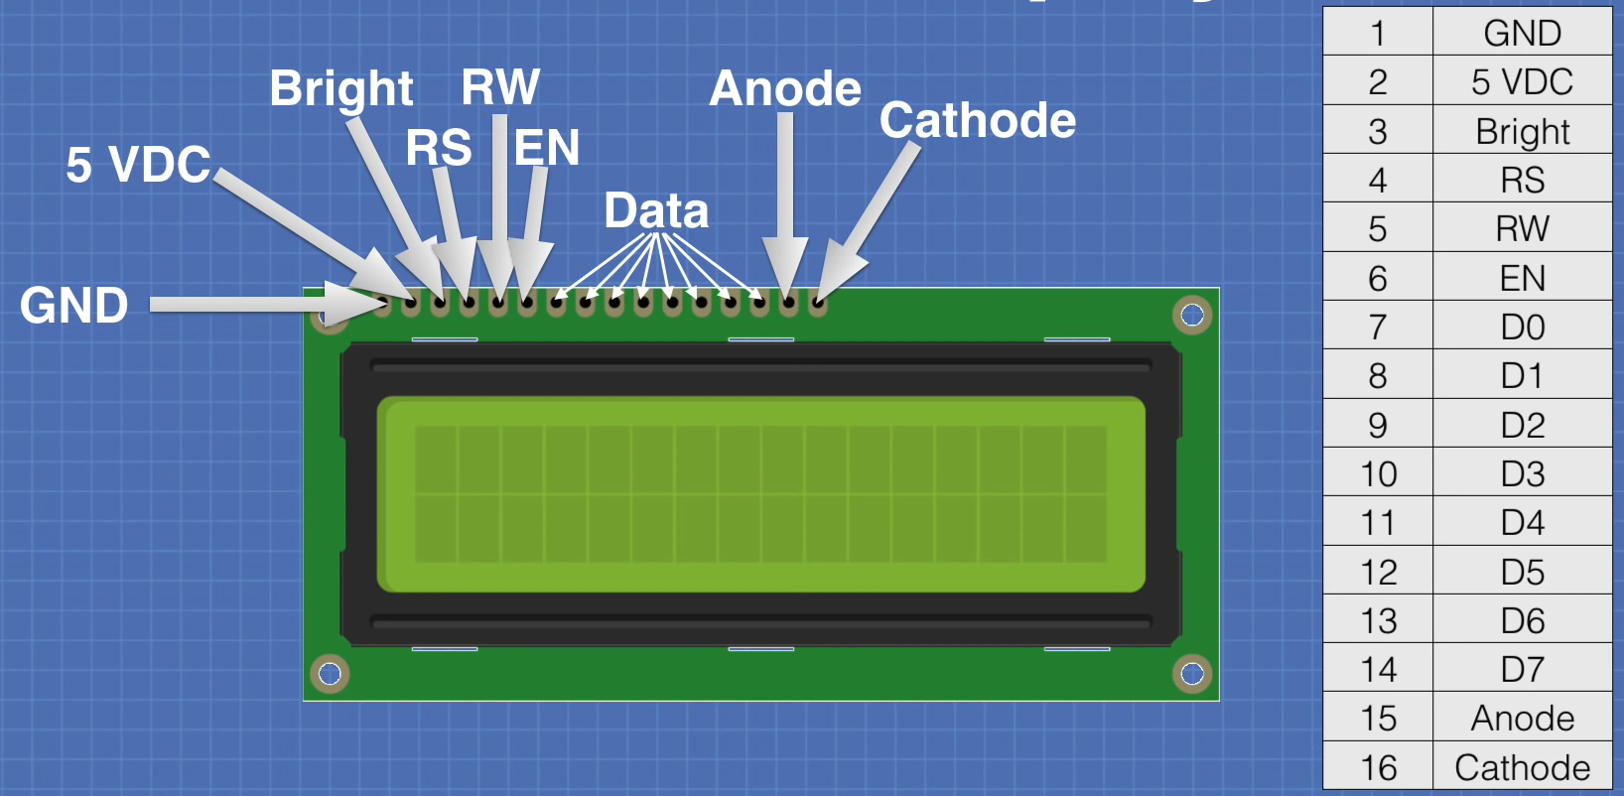
LCD can be interfaced either in 8-bit or 4-bit mode
RW = 1 (Read)
RW = 0 (Write) -> Microprocessor to Data Register to RAM
RS = 0 -> instruction register

Slide 25
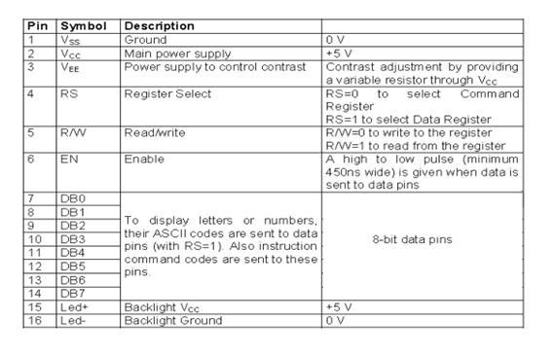
8 bit Mode – data transfers in 1 clock pulse through D0-D7
4 bit Mode – 8 bit data transfers in 2 clock pulses through D4-D7

Slide 26
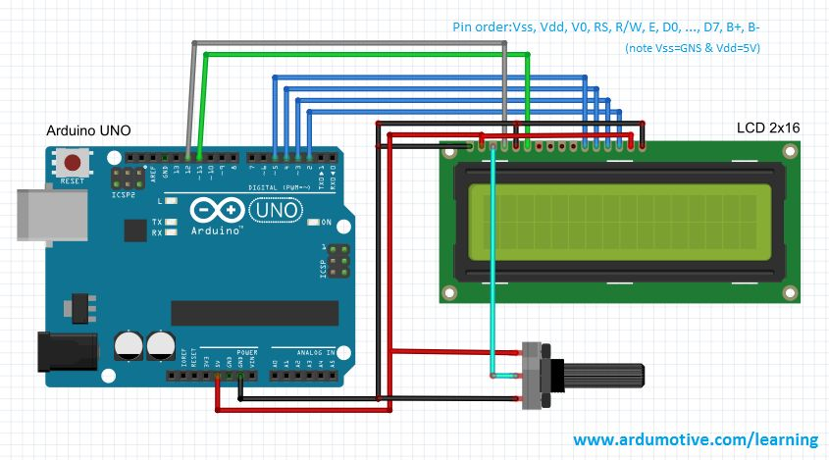
Connection with half byte mode

Slide 27
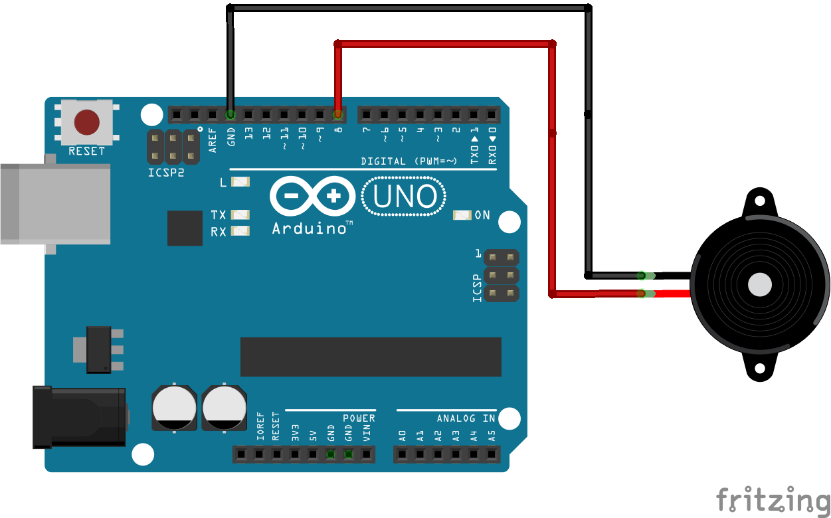
Buzzer

Slide 28
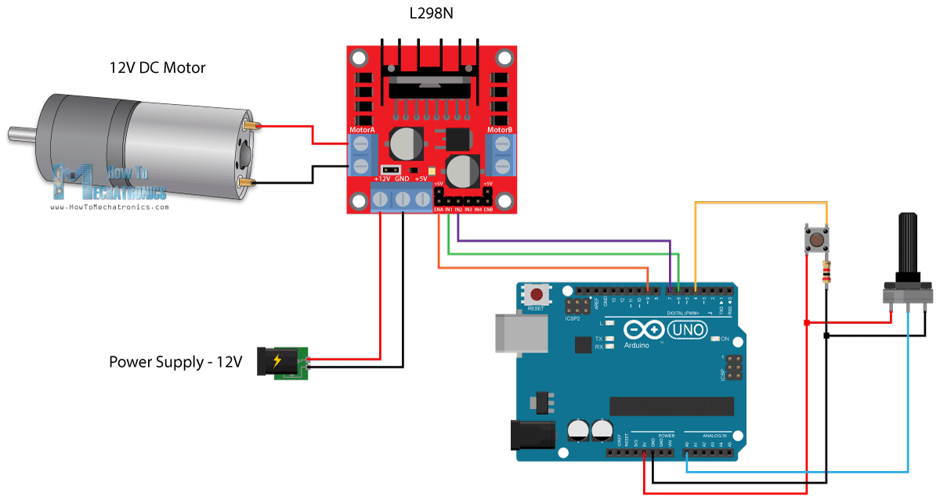
DC Motor

Slide 29
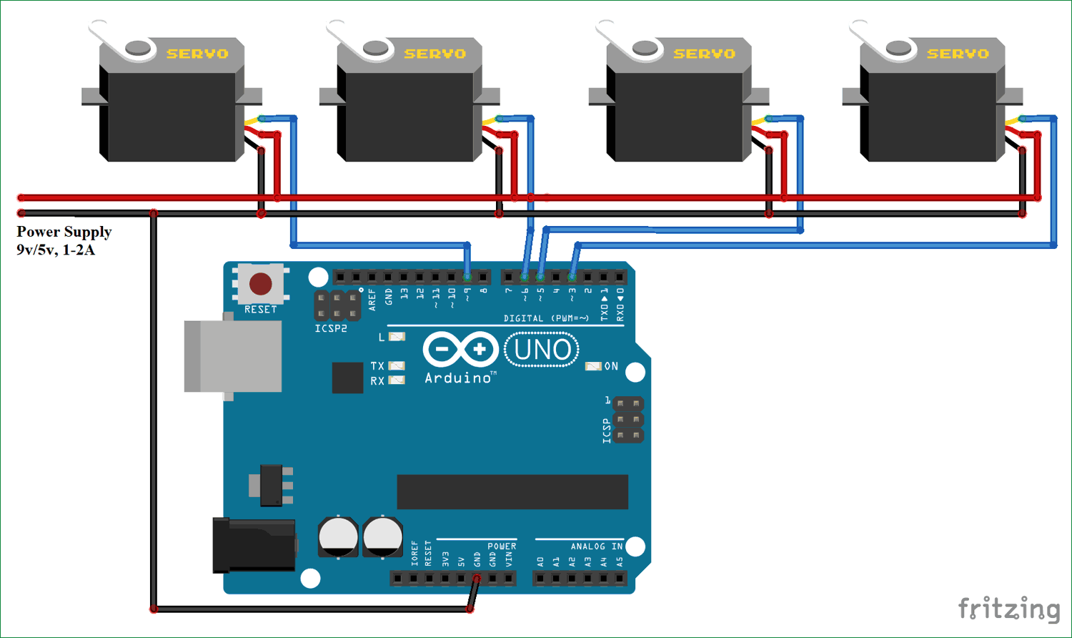
Servo Motor

Slide 30
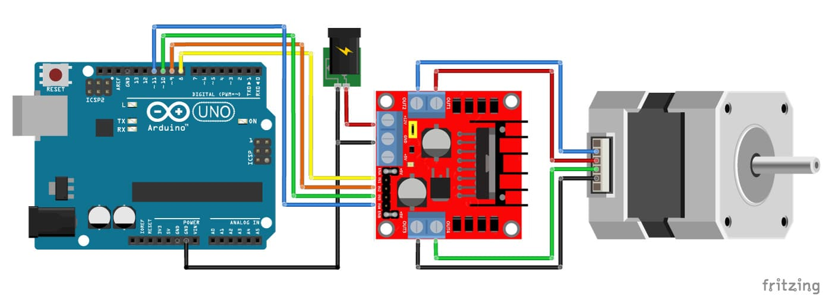
Stepper Motor

Slide 31
Input
Dip Switch
Push-Button Switch
Matrix Keyboard
Analog Input (Sensors)

Slide 32
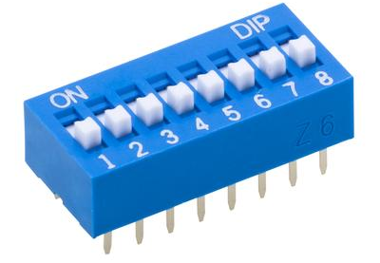
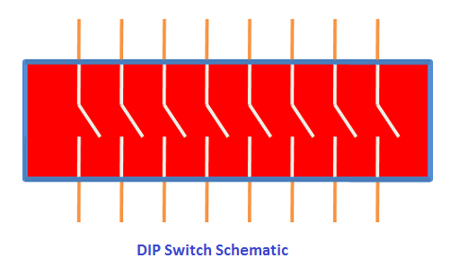
DIP switch
One side of the switch is tied high (to a power supply through a resistor called a pull-up resistor), and the other side is grounded. The logic level changes when the position is switched.

Slide 33
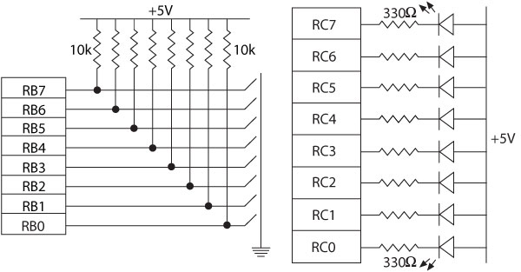
Interfacing Dip Switches and Interfacing LEDs

Slide 34
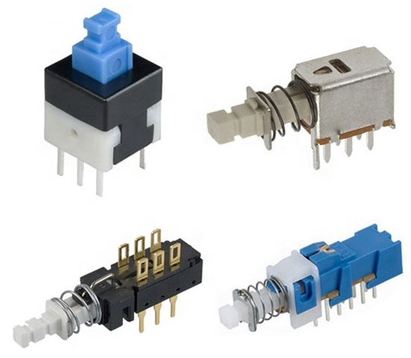
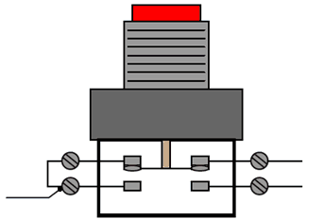
Push-button key
The connection is the same as in the DIP switch except that contact is momentary.
When a key is pressed (or released), mechanical metal contact bounces momentarily and can be read.

Slide 35
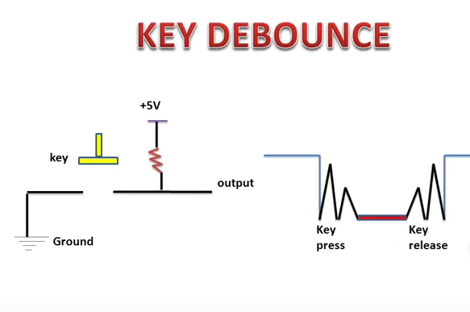

Slide 36
Key Debouncing
The reading of one contact as multiple inputs can be eliminated by a key-debounce technique, using either hardware or software.
Software Key Debouncing
Wait for 20 ms.
Read the port again.
If the reading is still less than FFH, it indicates that a key is pressed.

Slide 37
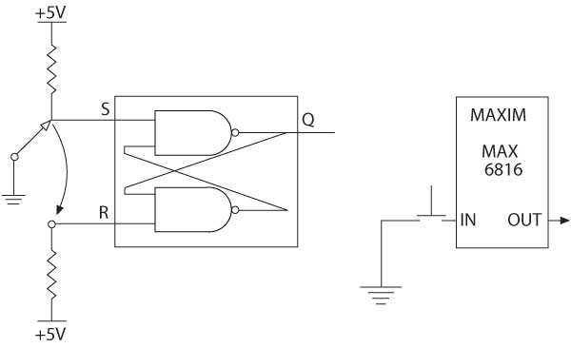
Hardware Key Debounce Techniques
Hardware technique is based on the principles of generating a delay and switching the logic level at a certain threshold level.
S-R latch: The output of the S-R latch is a pulse without a bounce.
Multiplexer that bounces the key internally and provides a steady output.

Slide 38
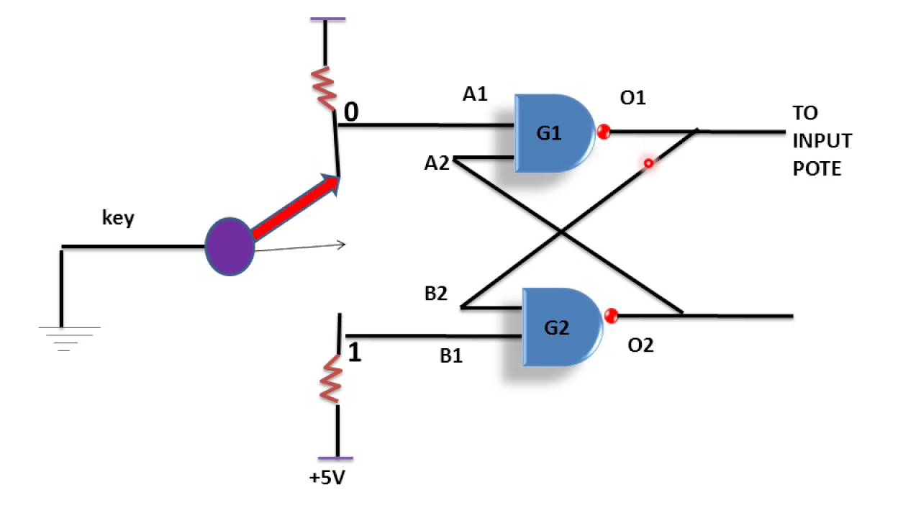
+5V
SR Latch
S
Q’
Q
R

Slide 39
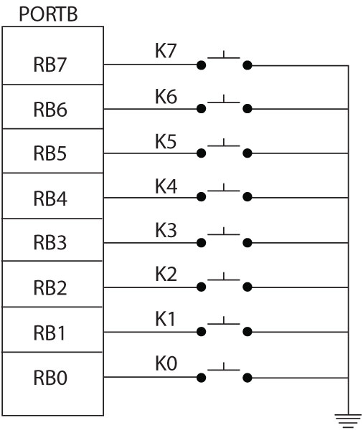
Illustration: Interfacing Push-Button Keys (1 of 6)
Problem statement
A bank of push-button keys are connected as inputs to PORTB.
The pull-up resistors are internal to PORTB.
Write a program to recognize a key pressed, debounce the key, and identify its location in the key bank with numbers from 0 to 7.

Slide 40
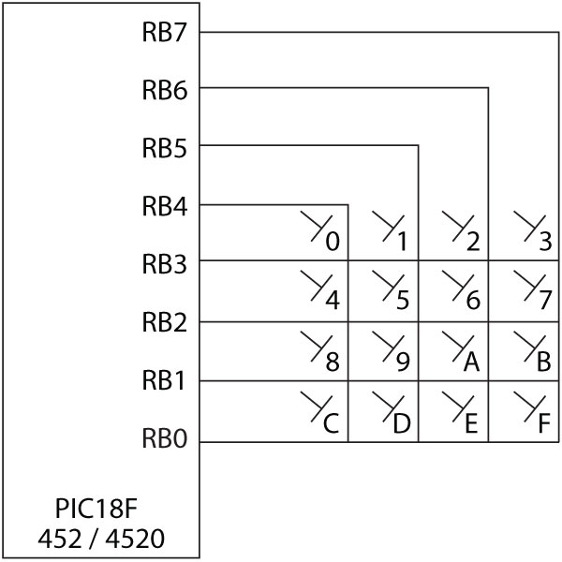
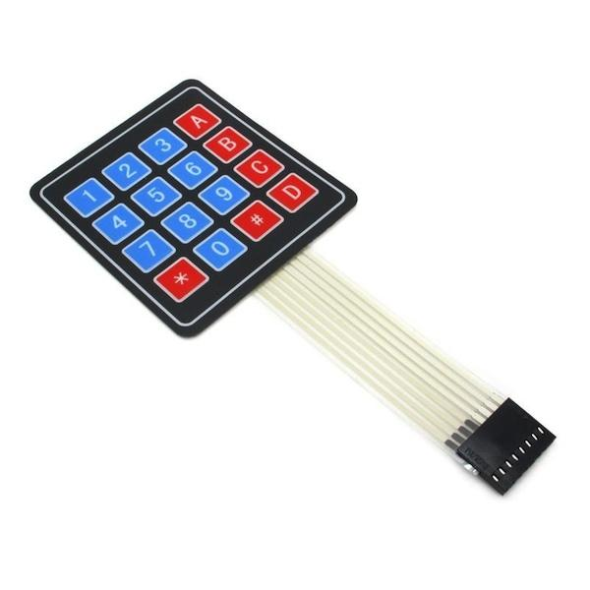
Interfacing a Matrix Keyboard

Slide 41
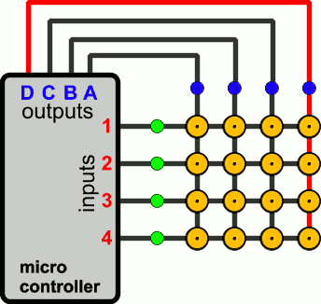
Interfacing a Matrix Keyboard
Ground one column at a time and check all the rows in that column.
Once a key is identified, it is encoded based on its position in the column.

Slide 42
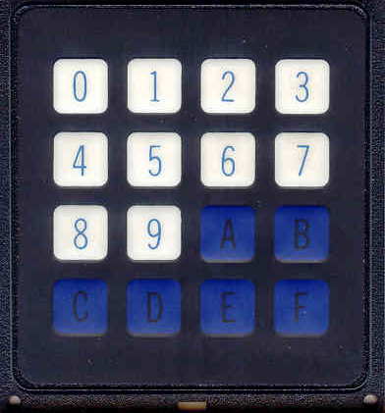
CSE360-Computer Interfacing BRAC University Keyboard Interfacing with MPU through 8255 PPI
0
‹#›

Slide 43
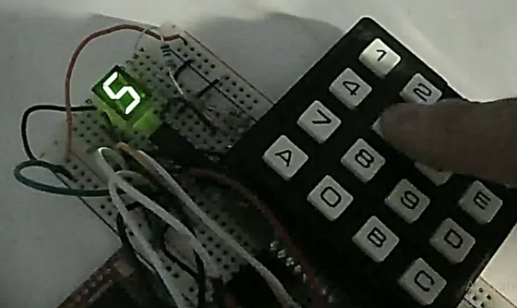
Hex Keyboard and 7-segment display
Content Credit: OPENBOX Education
‹#›

Slide 44
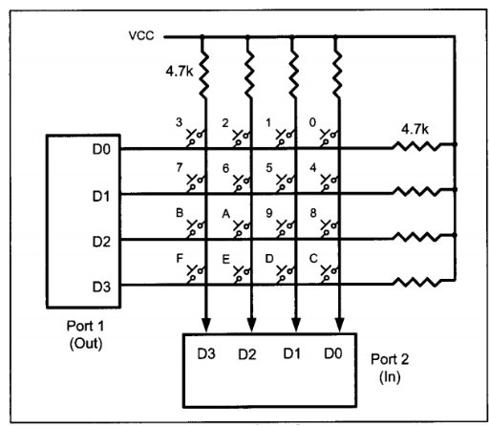
Hex Keyboard Interfacing
0
0
0
0
1
1
0
1
‹#›

Slide 45
Defining Control Register and Ports of 8255
We know there are four rows Suppose, R0 DB 0,1,2,3
R1 DB 4,5,6,7
R2 DB 8, 9, 0A, 0B
R3 DB 0C, 0D, 0E,0F
KEYPRESSED DB 0
8255 control word send to control register
MOV AL, 82H
OUT CWR, AL
Control Word Register (CWR)
8 |  |  |  | 2
1 | 0 | 0 | 0 | 0 | 0 | 1 | 0
I/0 | MODE 0 PORT A |  | PORT A Output |  | MODE 0 PORT B | PORT B Input
Content Credit: OPENBOX Education
‹#›

Slide 46
Column Identification
C3 | C2 | C1 | C0
1 | 1 | 1 | 1
Rows are grounded
MOV AL, 0 OUT PA, AL IN AL, PB CMP AL, 0FH JZ KEYPRESS CALL DELAY
3 | 2 | 1 | 0
7 | 6 | 5 | 4
B | A | 9 | 8
F | E | D | C
R0 | PA0 | 0
R1 | PA1 | 0
R2 | PA2 | 0
R3 | PA3 | 0
Columns are connected to VCC
1 | 1 | 1 | 1
PB3 | PB2 | PB1 | PB0
Content Credit: OPENBOX Education
‹#›

Slide 47
Column Identification
C3 | C2 | C1 | C0
1 | 1 | 1 | 1
MOV AL, 0 OUT PA, AL IN AL, PB CMP AL, 0FH JZ KEYPRESS CALL DELAY
KEYPRESS:
3 | 2 | 1 | 0
7 | 6 | 5 | 4
B | A | 9 | 8
F | E | D | C
R0 | PA0 | 0
R1 | PA1 | 0
R2 | PA2 | 0
R3 | PA3 | 0
0FH = 1111
1 | 1 | 0 | 1
PB3 | PB2 | PB1 | PB0
Content Credit: OPENBOX Education
‹#›

Slide 48
Row Identification – R0
C3 | C2 | C1 | C0
1 | 1 | 1 | 1
R0:
MOV AL, 1110 OUT PA, AL IN AL, PB CMP AL, 0FH JZ R1 LEA SI, R0 JMP COL
3 | 2 | 1 | 0
7 | 6 | 5 | 4
B | A | 9 | 8
F | E | D | C
R0 | PA0 | 0
R1 | PA1 | 1
R2 | PA2 | 1
R3 | PA3 | 1
1 | 1 | 1 | 1
PB3 | PB2 | PB1 | PB0
Content Credit: OPENBOX Education
‹#›

Slide 49
Row Identification – R1
C3 | C2 | C1 | C0
1 | 1 | 1 | 1
R1:
MOV AL, 1101 OUT PA, AL IN AL, PB CMP AL, 0FH JZ R2 LEA SI, R1 JMP COL
3 | 2 | 1 | 0
7 | 6 | 5 | 4
B | A | 9 | 8
F | E | D | C
R0 | PA0 | 1
R1 | PA1 | 0
R2 | PA2 | 1
R3 | PA3 | 1
1 | 1 | 1 | 1
PB3 | PB2 | PB1 | PB0
Content Credit: OPENBOX Education
‹#›

Slide 50
Row Identification – R2
C3 | C2 | C1 | C0
1 | 1 | 1 | 1
R2:
MOV AL, 1011 OUT PA, AL IN AL, PB CMP AL, 0FH JZ R3 LEA SI, R2 JMP COL
3 | 2 | 1 | 0
7 | 6 | 5 | 4
B | A | 9 | 8
F | E | D | C
3 | 2 | 1 | 0
7 | 6 | 5 | 4
B | A | 9 | 8
F | E | D | C
R0 | PA0 | 1
R1 | PA1 | 1
R2 | PA2 | 0
R3 | PA3 | 1
0 | 1 | 1 | 1
PB3 | PB2 | PB1 | PB0
1 | 1 | 0 | 1
PB3 | PB2 | PB1 | PB0
Content Credit: OPENBOX Education
‹#›

Slide 51
Row Identification – R3
C3 | C2 | C1 | C0
1 | 1 | 1 | 1
R3:
MOV AL, 0111 OUT PA, AL IN AL, PB CMP AL, 0FH JZ R1 LEA SI, R3 JMP COL
3 | 2 | 1 | 0
7 | 6 | 5 | 4
B | A | 9 | 8
F | E | D | C
R0 | PA0 | 1
R1 | PA1 | 1
R2 | PA2 | 1
R3 | PA3 | 0
1 | 1 | 1 | 1
PB3 | PB2 | PB1 | PB0
Content Credit: OPENBOX Education
‹#›

Slide 52
Key Press Identification
We got the value of column 1101 from Row 2 (R2)
Now we have to find the 0 by shift right (SHR) operation to find out the corresponding value and store that into KEYPRESS variable.
MOV AL, [SI] MOV KEYPRESSED, AL
1 | 1 | 0 | 1
R2 | 8 | 9 | 0A | 0B
[SI]
Content Credit: OPENBOX Education
‹#›

Slide 53
.
Thank You For Your Attention
‹#›

Slide 54
Sensors will be discussed in next session…

